Slide 1
Medicaid Myths: Debunking Common Misconceptions of the Medicaid Program
Tuesday, July 9; 12pm
Shannon Attanasio
Vice President, Government Relations and Advocacy, Medicaid Health Plans of America
Olanrewaju Falusi, MD, FAAP
Pediatrician, Children’s National Health System
Sara Rosenbaum, JD
Harold and Jane Hirsh Professor, Health Law and Policy, Milken Institute School of Public Health, the George Washington University
Desmond Williams
Client Advocate, Health Care for the Homeless

Slide 2
AFL-CIO American Academy of Family Physicians American Academy of Pediatrics American College of Obstetricians and Gynecologists American Dental Association American Dental Education Association American Health Care Association America’s Essential Hospitals Association for Community Affiliated Plans Association of Clinicians for the Underserved Catholic Health Association of the United States Children’s Hospital Association Easterseals The Jewish Federations of North America Medicaid Health Plans of America National Association of Community Health Centers National Association of Counties National Association of Pediatric Nurse Practitioners National Association of Rural Health Clinics National Council for Behavioral Health National Health Care for the Homeless Council National Hispanic Medical Association National Rural Health Association

Slide 3
Medicaid: A Children’s Health Program
Olanrewaju Falusi, MD, FAAP
Pediatrician, Children’s National Health System
Past President, American Academy of Pediatrics D.C. Chapter

Slide 4
Myth: Medicaid is only for low-income adults
Fact: The Medicaid expansion adult population represents less than 20 percent of the 75 million individuals enrolled in Medicaid.
35 million Medicaid beneficiaries are children
10.7 million Medicaid beneficiaries are disabled
6 million Medicaid beneficiaries are elderly – often “dual-eligible” with Medicaid helping to defray Medicare costs
Source: “CMS Fast Facts.” (2019). Centers for Medicare and Medicaid Services. Retrieved from https://www.cms.gov/Research-Statistics-Data-and-Systems/Statistics-Trends-and-Reports/CMS-Fast-Facts/index.html
Notes:
Read statistics on the slide
Because I am a pediatrician, my presentation will focus on the important role Medicaid plays for our nation’s children.
My number one goal is for you to leave here today thinking about Medicaid as a children’s health program.

Slide 5
How are Children Covered in the United States?
Notes:
I want to first take a step back and talk about how the children in our country get health insurance coverage.
Most children covered by ESI through parent’s job
But almost 40% in Medicaid/CHIP
When we look at our nation’s most low-income children (below 200% FPL), Medicaid covers more than 2/3 of those children.

Slide 6
Public Coverage for Children, 2017
Medicaid
36.9 million
CHIP
9.5 million
Marketplace
1 million
Notes:
Medicaid is the MVP for kids – covering over 37m kids in 2016 including many vulnerable children like children living in poverty, children with disabilities
Medicaid is a kids program – almost half of all enrollees are children
Source: AAP/CCF Children’s Coverage Fact Sheets

Slide 7
Children make up 50% of Medicaid/CHIP Beneficiaries
Notes:
Medicaid plays an important role for vulnerable groups of children
Many of these children face adverse child experiences like abuse, neglect, exposure to violence and family dysfunction
These can lead to poor school performance, developmental delays, juvenile justice involvement, and poor health in adulthood

Slide 8
Medicaid’s Robust Pediatric Benefit – EPSDT
Notes:
EPSDT is the Medicaid program’s federally guaranteed benefit for all Medicaid enrollees under age 21.
Under EPSDT, Medicaid must provide a comprehensive array of preventive, diagnostic, and treatment services.
States are required to set up a periodicity schedule; periodicity schedule must follow reasonable standards of medical and dental practice and must be developed through consultation with medical and dental organizations involved in the care of children.
American Academy of Pediatrics’ Bright Futures is an available periodicity schedule.
Example of how EPSDT plays out in the your office – 1yo wcc, devel screenings, vaccines, anemia and lead screening, fluoride varnish

Slide 9
Medicaid’s Covered Services
Under EPSDT, states must cover all medically necessary services,
including those that are “optional” for adults
Mandatory Services
Family planning services and supplies
Federally Qualified Health Clinics and Rural Health Clinics
Home health services
Inpatient and outpatient hospital services
Laboratory and X-Rays
Medical supplies and durable medical equipment
Non-emergency medical transportation
Nurse-midwife services
Pediatric and family nurse practitioner services
Physician services
Pregnancy-related services
Tobacco cessation counseling and pharmacotherapy for pregnant women
Optometry services
Other diagnostic, screening, preventive and rehabilitative services
Other licensed practitioners’ services
Physical therapy services
Prescribed drugs
Primary care case management services
Private duty nursing services
Program of All-Inclusive Care for the Elderly (PACE) services
Prosthetic devices
Respiratory care for ventilator dependent individuals
Speech, hearing and language disorder services
Targeted case management
Tuberculosis-related services
Optional Services
Community supported living arrangements
Chiropractic services
Clinic services
Critical access hospital services
Dental services
Dentures
Emergency hospital services (in a hospital not meeting certain federal requirements)
Eyeglasses
State Plan Home and Community Based Services
Inpatient psychiatric services for individuals under age 21
Intermediate care facility services for individuals with intellectual disabilities
Source: Social Security Act §1905(a)
Notes:
Medicaid must cover treatments or procedures necessary to “correct or ameliorate defects and physical and mental illnesses and conditions”
A service does not need to cure a condition to be covered; the concept of “ameliorate” is unique to children under EPSDT. A service that improves or makes a condition better is covered because it fits under the “ameliorate” definition
If that 1yo shows delays, Medicaid will cover PT/speech/etc.

Slide 10
Medicaid Helps Children Succeed
Notes:
IMPACT OF MEDICAID BEYOND HEALTH CARE: Based on longitudinal research based on child coverage expansions in the 1980s, we know that having Medicaid as a child helps mitigate effects of poverty, adverse childhood experiences:
Children with Medicaid become healthier adults – ex. Longitudinal analysis showed a 26%pt decline in the incidence of high blood pressure in adulthood and lower rates of hospitalizations and emergency room visits in adulthood. And some benefits accrued faster – children with Medicaid had lower rates of eating disorders, drinking and mortality as adolescents.
2. We also found that children with Medicaid were less likely to drop out of high school and more likely to go to college
3. And had greater economic success as adults. Children with Medicaid access had higher incomes later in life and were more likely to surpass their families’ economic status.

Slide 11
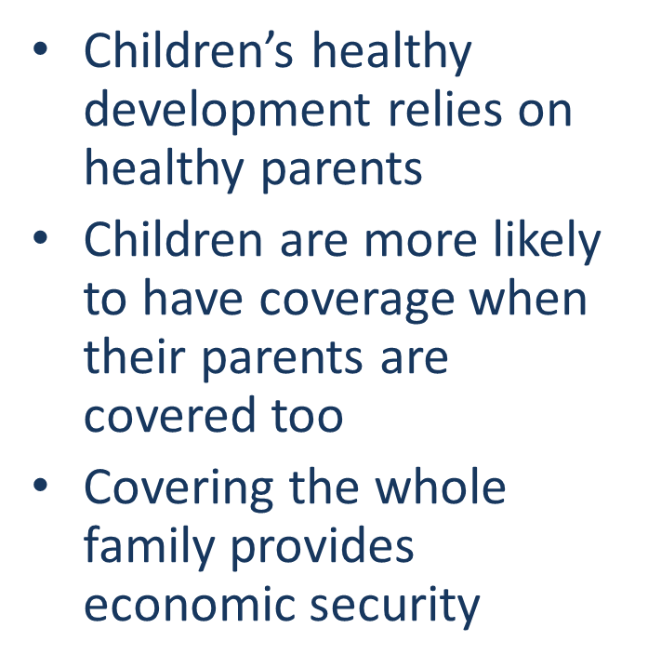
Coverage for Parents is Good for Kids
Notes:
Children’s relationships with adults in their lives influence healthy development
Poor adult health associated with adverse childhood experience costs over $185 billion annually in cardiovascular and mental health care
Positive outcomes for children rely on the overall health of their parents/caregivers
Access to prenatal care is critical for early brain development
Maternal depression has a negative impact on young children’s cognitive and social-emotional development, as well as education and employment later in life

Slide 12
After Years of Progress, We’re Losing Ground
Notes:
The rate of uninsured children ticked up in 2017 for the first time in over a decade (276K children)
The rate of uninsured young children (under 6yo) also went in the wrong direction – ticking up from 3.8 in 2016 to 4.2% in 2017
Won’t see 2018 uninsured figures until the Fall, but here’s some ominous foreshadowing
In 2018, the number of children in Medicaid/CHIP fell by 729,000
Source= Georgetown CCF Report: Medicaid and CHIP Enrollment Decline Suggests the Child Uninsured Rate May Rise Again: https://ccf.georgetown.edu/2019/05/28/medicaid-and-chip-enrollment-decline/
Possible reasons for the decline: State specific factors related to eligibility systems; Delay in CHIP funding; Uncertainly around health reform proposals; Repeal of individual mandate penalty; Reduced funding for outreach and consumer assistance; Public charge fear
There is scant evidence that the enrollment drop is primarily the result of a strong economy: While the economy has been gaining strength in terms of job growth over the past decade, until recently, overall real wage growth in excess of inflation has been modest. Moreover, there is little indication that access to affordable employer-sponsored health insurance (ESI) has improved for parents with dependent children, particularly for low-wage workers. In fact, even with a decade of economic growth, the long-term trend has been a declining share of non-elderly people enrolled in ESI with incomes between 100 percent and 400 percent federal poverty level (FPL).5 Although there is some sign of a small increase in the share of employers offering ESI, only 60 percent of workers in these firms are enrolled since some are not eligible and others opt not or cannot afford to enroll (known as take-up rates). Among employers with many lower wage workers, enrollment in ESI was only about one-third. Moreover, only one in five children (20.6 percent) in families with income below 200 percent FPL are enrolled in ESI, while nearly two-thirds of them (65.3 percent) rely on Medicaid and CHIP to access health care.

Slide 13
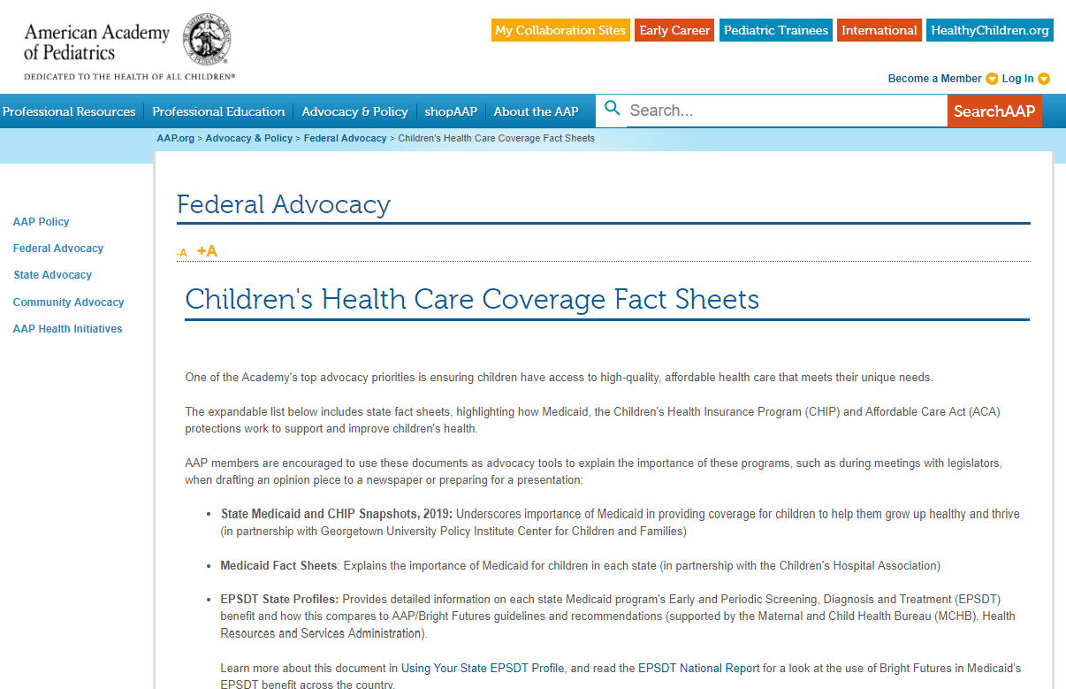
Want to Learn More About How Children Are Covered in Your State?
Visit www.aap.org
Click on Children's Health Care Coverage Fact Sheets
Follow us on Twitter @AmerAcadPeds
Notes:
Fact sheets are available for all 50 states
Reach out to your state’s local AAP chapter

Slide 14
Medicaid Myths: Debunking Common Misconceptions of the Medicaid Program
Tuesday, July 9; 12pm
Shannon Attanasio
Vice President, Government Relations and Advocacy, Medicaid Health Plans of America
Olanrewaju Falusi, MD, FAAP
Pediatrician, Children’s National Health System
Sara Rosenbaum, JD
Harold and Jane Hirsh Professor, Health Law and Policy, Milken Institute School of Public Health, the George Washington University
Desmond Williams
Client Advocate, Health Care for the Homeless

Slide 15
Questions?

